Slide 1
Securing Sensitive Data in Android Applications
OWASP Reference: OWASP Mobile Top 10 – Insecure Data Storage Emphasize the importance of protecting sensitive data to prevent unauthorized data access.

Slide 2
Objective of This Tutorial
Goal: Demonstrate insecure storage, identify vulnerabilities using MobSF, and secure the data with EncryptedSharedPreferences.
Key Steps:
Build an Android app with insecure storage.
Run MobSF (Mobile Security Framework) analysis.
Secure the app following OWASP recommendations.

Slide 3
Setting Up the Insecure App
Use attached insecurestoragapp android application code base
to build apk file using Android Studio

Slide 4
Implementing Insecure Data Storage
Insecure Code Implementation: Store the access token in plain text using SharedPreferences.
Insecurestoragapp Code Snippet: Include a sample snippet showing unencrypted token storage.
OWASP Reference: OWASP MASVS - MSTG-STORAGE Highlight that storing sensitive data in plaintext can lead to data exposure if a device is compromised.

Slide 5
Introduction to Data Security in Mobile Apps
Why Data Security Matters: Discuss the critical need for secure data storage, especially for sensitive information like access tokens.
Common Mistakes: Introduce how common storage approaches like unencrypted SharedPreferences can expose sensitive data.
OWASP Reference: OWASP Mobile Top 10 - Insecure Data Storage Emphasize the importance of protecting sensitive data to prevent unauthorized access.

Slide 6
Tutorial Outline:
Develop Vulnerable Android app
Demo: Vulnerabilities
Demo: Code Fix
Demo: Validate Fix

Slide 7
Develop Vulnerable Android app
Open Android Studio.
Select New Project → Empty Activity.
Name the project “insecurestoragapp”
Set the Minimum SDK to API 21 (Lollipop) or higher.
Click Finish to create the project.
Override MainActivity.kt and activity_main.xml files from attached insecurestoragapp codebase folder
7. Build apk file using Android Studio or use InSecureStorageDemoApp.apk available in attached insecurestoragapp code base folder

Slide 8
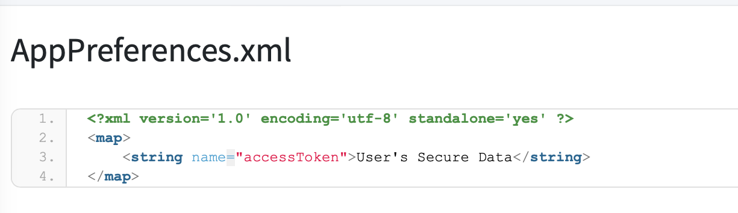
Demo: Vulnerabilities
Demo - https://youtu.be/LvMMOr6miN4
MobSF Dynamic Analysis able to extract user data from mobile app preferences in plain text format

Slide 9
Demo: Code fix
Open insecurestoragapp code using Android Studio
Override MainActivity.kt and activity_main.xml files from attached securestoragapp codebase folder
Override build.gradle.kts file files from attached securestoragapp codebase folder and sync build
Build apk file using Android Studio or use SecureStorageDemoApp.apk available in attached securestoragapp code base folder

Slide 10
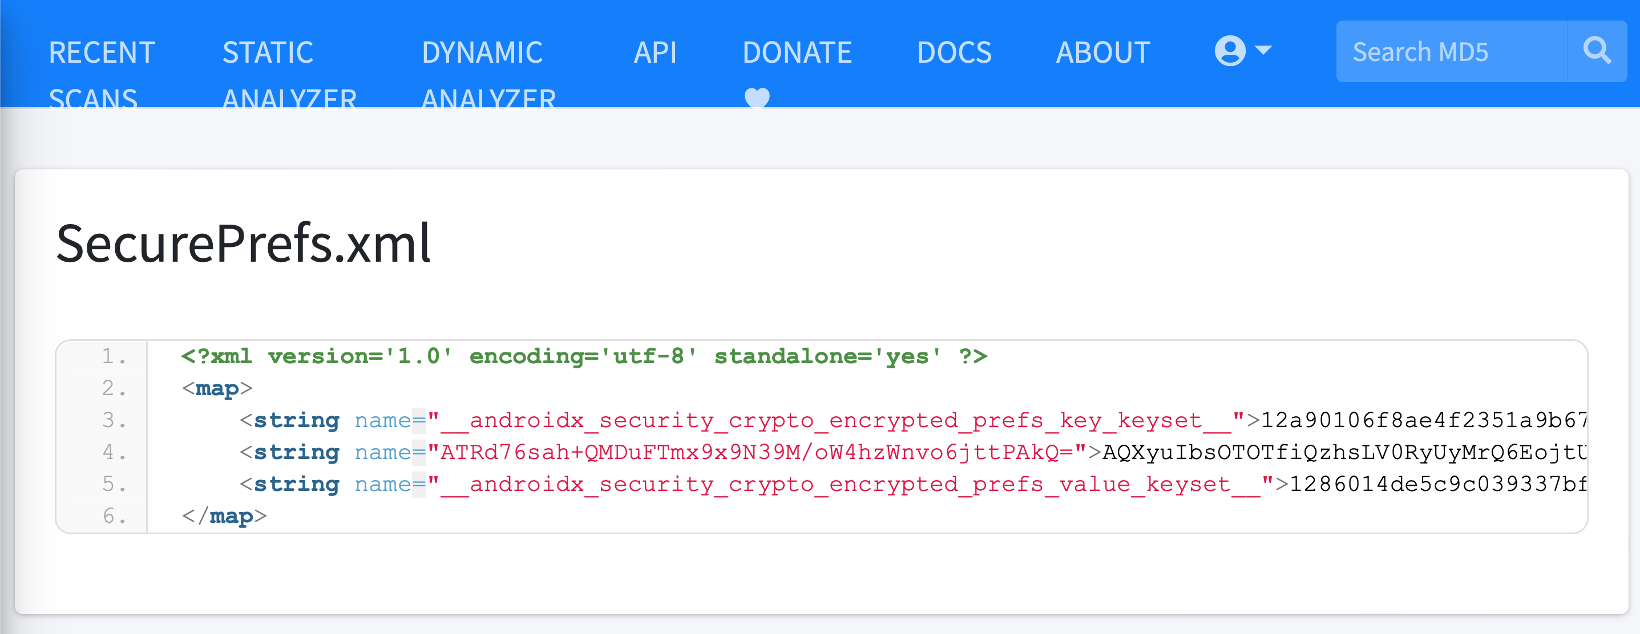
Demo: Validate Fix
Demo - https://youtu.be/HfLHrqtYu2E
MobSF Dynamic Analysis unable to extract user data from mobile app SecurePrefs in encrypted text

